Slide 1

CS799: Master’s Thesis Project
Deep Learning Based Approaches for Medical VQA
Department of Computer Science and Engineering
Indian Institute of Technology, Ropar
Instructor:
Deepti R. Bathula:
Assistant Professor
Department of Computer Science & Engineering
Presented By:
Anurag Jaiswal (2021CSM1002)

Slide 2
Contents
Introduction
Problem Statement
Literature Review
Datasets
Progress
Post Mid Sem Work
Experiment & Preliminary Results
Timeline

Slide 3
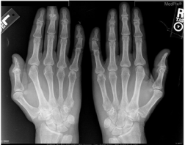
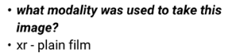
Introduction (Contd.)
In the medical domain, an image corresponds to a radiology scan of a patient accompanied by a clinically relevant question-answer pair, where the answer might belong to a pre-defined limited set or can be a sequence of words

Slide 4
Problem Statement
Given a medical Image and a natural language question about the image, the task is to provide an accurate natural language answer from a possible set of answers.

Slide 5
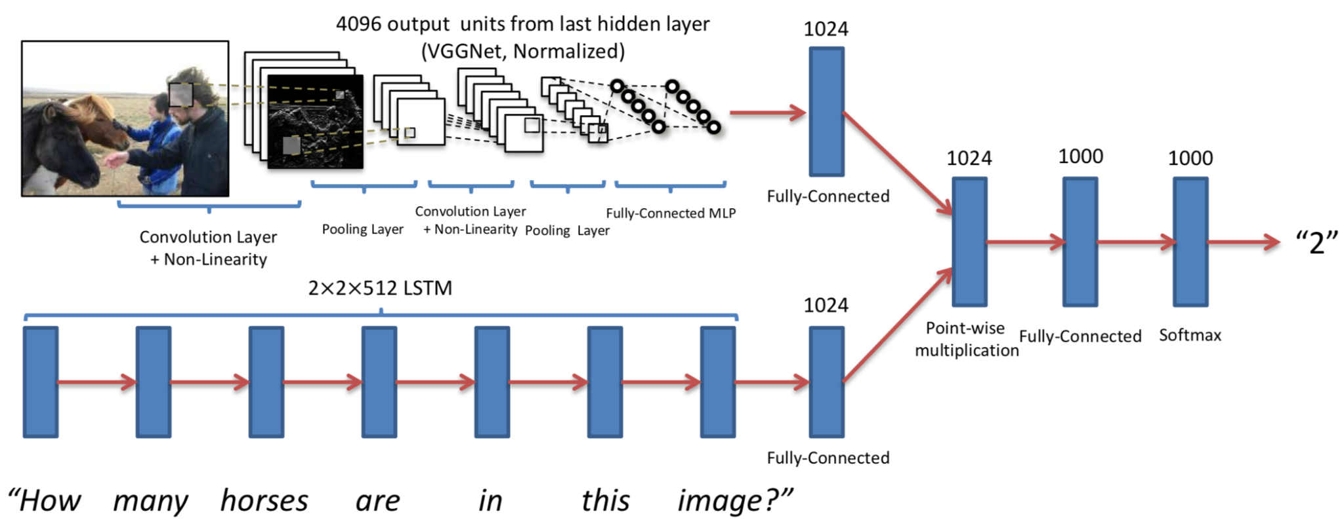
VQA Models
Baseline Method
Image Encoding: VGG19 + Question Encoding: LSTM
Combined the inputs using element wise multiplication
Passed through two fully connected layers before finally taking a softmax
Agrawal et. al, VQA Visual Question Answering IJCV 2015

Slide 6
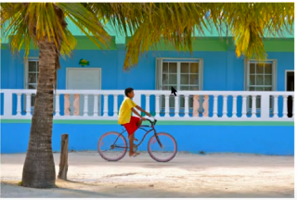
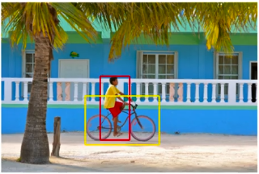
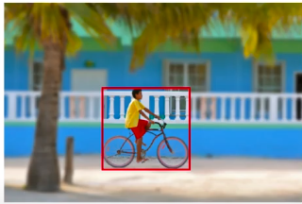
VQA Models (Contd.)
Attention: Intuition
How to answer this question?
What is the boy doing ?
Pay attention to the relevant artifacts
Cecilia Schubert, Wikimedia.org, CC License

Slide 7
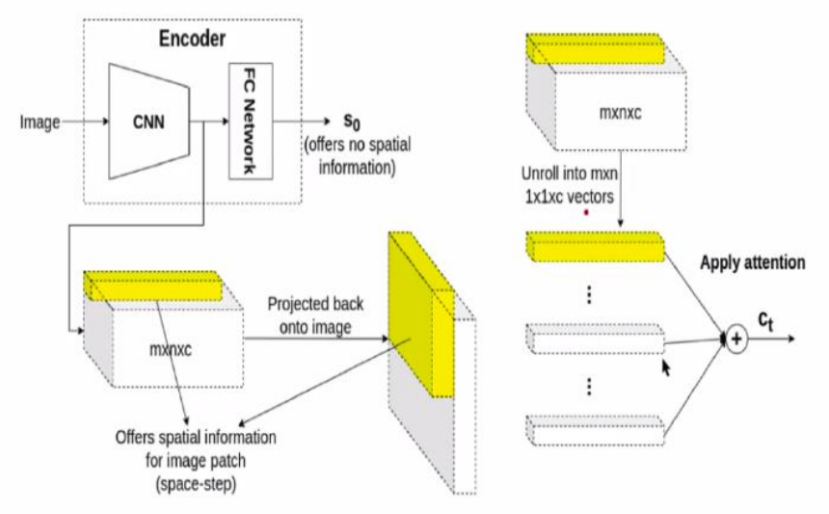
VQA Models (Contd.)
Attention Mechanism for Spatial Data
Instead of using FC layers, take the output of the convolution layers themselves, which provides certain volume mxnxc.
By considering the specific patch of volume mxnxc, we can trace back to a particular patch of the original image which was passed through CNN.
As by looking at one particular path part of that depth volume, we would get a certain patch in the input image which provides spatial information.

Slide 8
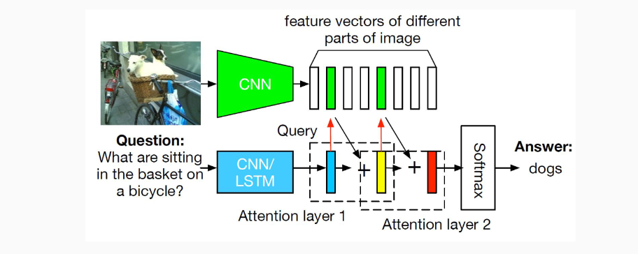
VQA Models (Contd.)
Stacked Attention Networks for Image Question Answering
Yang et al, Stacked Attention Network for Image Question Answering CVPR 2016

Slide 9
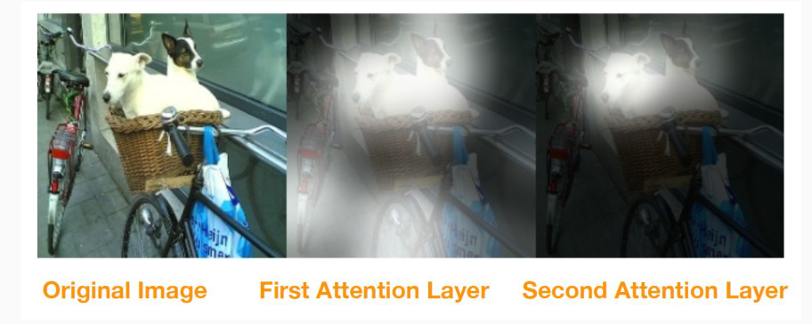
VQA Models (Contd.)
The stacked attention network first focuses on all referred concepts, e.g. bicycle,basket and objects in the basket (dogs) in the first attention layer
Yang et al, Stacked Attention Network for Image Question Answering CVPR 2016

Slide 10
VQA MixUp
A data augmentation technique that extends the conventional MixUp to VQA task.
MixUp (MX) : Generate new image Vmix with ground truth labels Amix as a weighted combination of original images Vx and Vy and their corresponding ground truth labels Ax and Ay using the following equations:
V_{mix}= λV_{x} + (1 − λ)V_{y}
where the value of mixing parameter λ ∈ [0, 1] is chosen randomly from a Beta distribution with α as the hyper-parameter.
MEDICAL VQA: MIXUP HELPS KEEP IT SIMPLE.2022

Slide 11
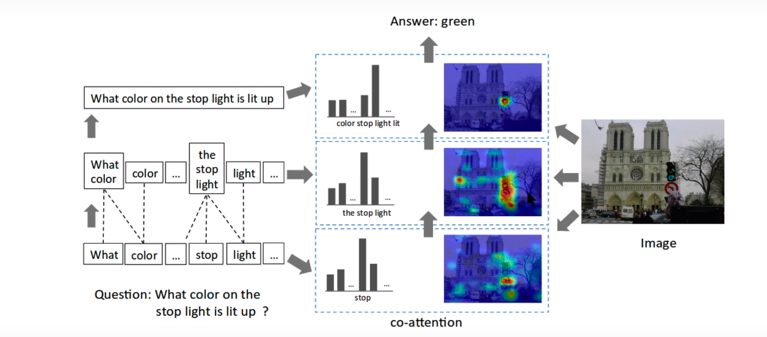
Hierarchical Question-Image Co-Attention
Given a question, extract its word level, phrase level and question level embeddings
At each level, apply co-attention on both image and question
Final answer prediction is based on all co-attended image and question features
Lu et al, Hierarchical Question-Image Co-Attention for Visual Question Answering, NeurIPS 2016

Slide 12
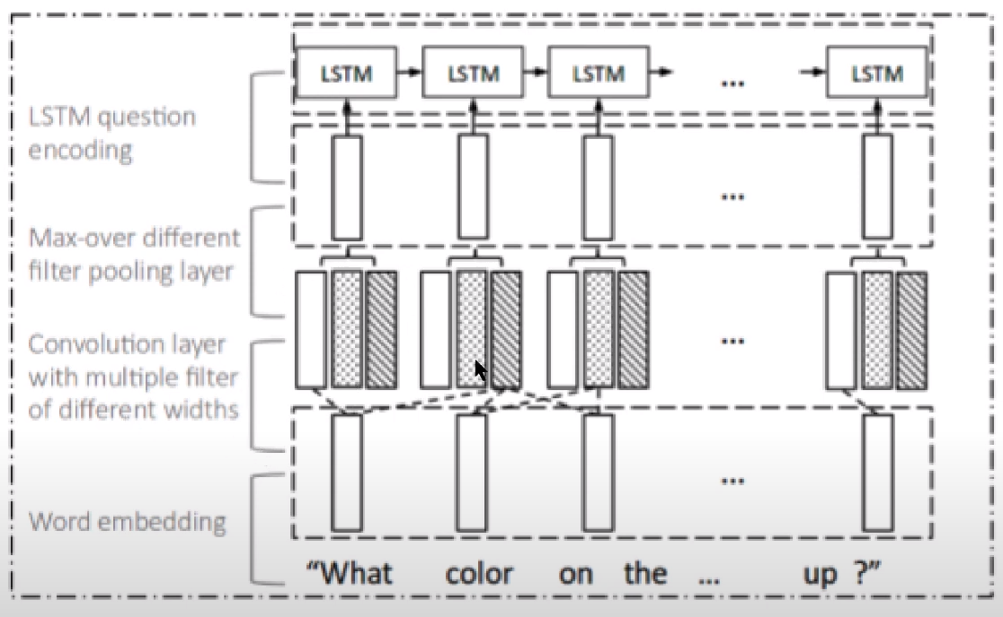
VQA Models (Contd.)
At a word level, we get a word-
level embedding.
To get the phrase-level embedding, we can take embeddings of each word of caption.
Then perform convolution across those inputs with multiple filters of different widths.
We will get vector representations such as these, which are what we call phrase-level embeddings.
Then we perform max pool over the convolution layer. And we then get a question-level embedding through the LSTM, which we give that max pool output.
That gives us a representation at the question level.
Question Hierarchy
Question
Level
Phrase
Level
Word Level

Slide 13
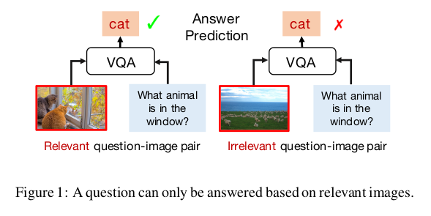
Language Priors
An intuitive observation: a question can only be answered based on relevant on image.
Estimate the relevance between questions and images before answering questions.
Proceedings of the Twenty-Ninth International Joint Conference on Artificial Intelligence (IJCAI-20)

Slide 14
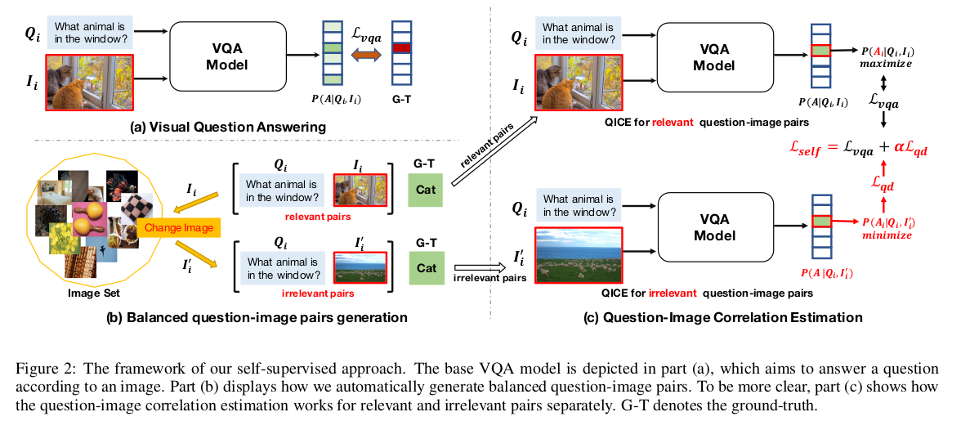
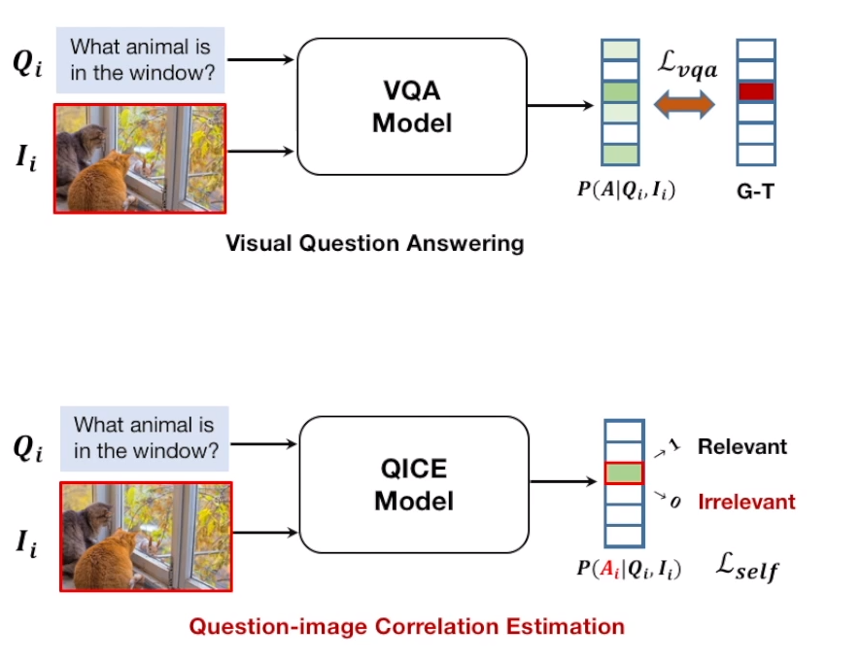
Unified Self-supervised VQA Framework
Settle the visual question answering task and the question-image correlation estimation task concurrently in a unified VQA framework.
Proceedings of the Twenty-Ninth International Joint Conference on Artificial Intelligence (IJCAI-20)

Slide 15
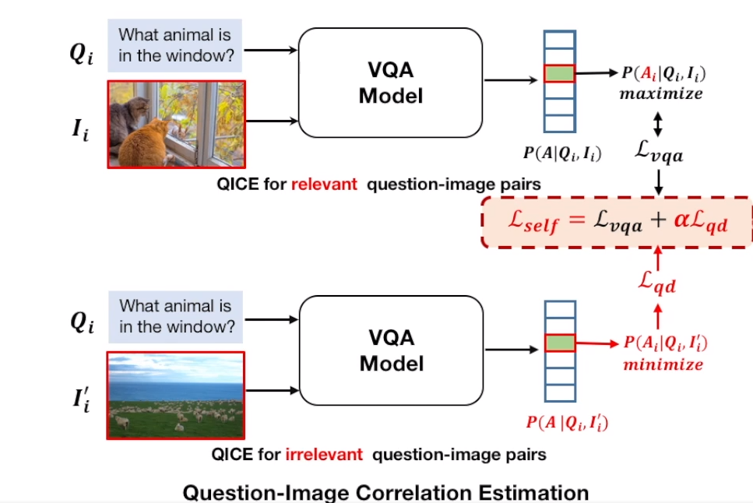
Unified Self-supervised VQA Framework
Objective Function.
Proceedings of the Twenty-Ninth International Joint Conference on Artificial Intelligence (IJCAI-20)

Slide 16
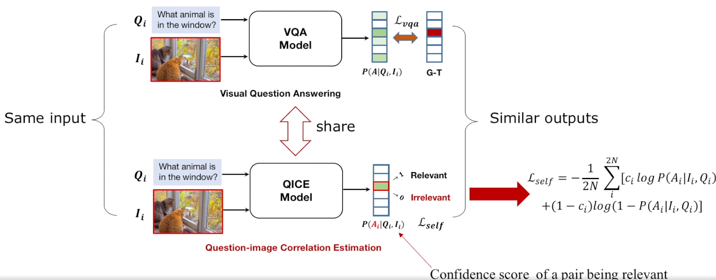
Unified Self-supervised VQA Framework
Objective Function.
Proceedings of the Twenty-Ninth International Joint Conference on Artificial Intelligence (IJCAI-20)

Slide 17
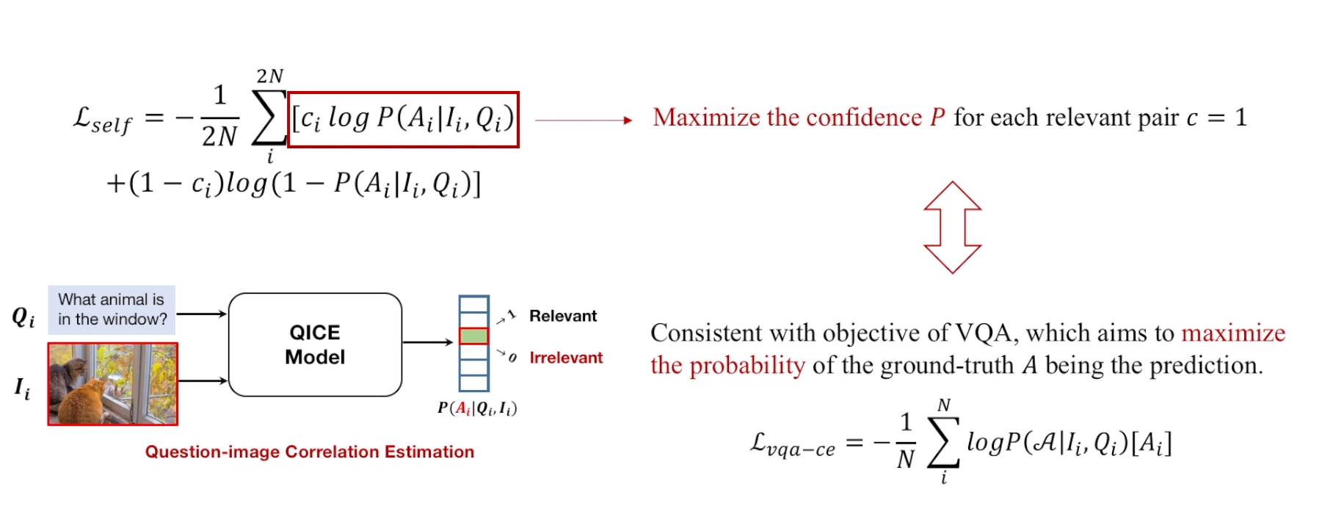
Auxiliary Task & VQA
The first term of question-image correlation estimation loss Lself , which is only valid for relevant question-image pairs, is consistent with the objective of VQA.
Proceedings of the Twenty-Ninth International Joint Conference on Artificial Intelligence (IJCAI-20)

Slide 18
Literature Survey
Antol, Stanislaw, et al. "Vqa: Visual question answering." Proceedings of the IEEE international conference on computer vision. 2015.
Zhu, Xi, et al. "Overcoming language priors with self-supervised learning for visual question answering." arXiv preprint arXiv:2012.11528 (2020).
Singh, Jitender, Dwarikanath Mahapatra, and Deepti R. Bathula. "MEDICAL VQA: MIXUP HELPS KEEP IT SIMPLE." (2022).
Khare, Yash, et al. "MMBERT: multimodal BERT pretraining for improved medical VQA." 2021 IEEE 18th International Symposium on Biomedical Imaging (ISBI). IEEE, 2021.
Thanki, Abhishek, and Krishnamoorthi Makkithaya. "MIT Manipal at ImageCLEF 2019 Visual Question Answering in Medical Domain." CLEF (Working Notes). 2019.
Yang, Zichao, et al. "Stacked attention networks for image question answering." Proceedings of the IEEE conference on computer vision and pattern recognition. 2016.

Slide 19
Progress
Implemented one of the basic vqa model and stacked attention model for natural images and able to reproduce the results.
Understanding of medical dataset analysis
Working on identifying the smart question image pairing technique along with random sample pairing on medical image dataset.

Slide 20
Future Work
Implement basic vqa model along on imageCLEF and VQA-RAD dataset.
Implement Attention Mechanism for vqa on imageCLEF and VQA-RAD dataset.
Implement Attention mechanism vqa along with mixup technique or QICE model with random and smart pairing.
Keep evolving the model with better question image pairing technique.
Validate result with test data for better accuracy and lower error rate.

Slide 21
Post Mid Sem Work

Slide 22
Datasets (ImageCLEF)
ImageCLEF |  | 2018 | 2019 | 2020
 | Unique Images | 2278 | 3200 | 4000
Train | Unique Questions | 4728 | 247 | 38
 | Unique Answers | 4471 | 1552 | 332
Test | Unique Images | 324 | 500 | 500
 | Unique Questions | 331 | 186 | 26
 | Unique Answers | 389 | 470 | 332
Valid | Unique Images | 264 | 500 | 343
 | Unique Questions | 388 | 138 | 138
 | Unique Answers | 456 | 470 | 470

Slide 23
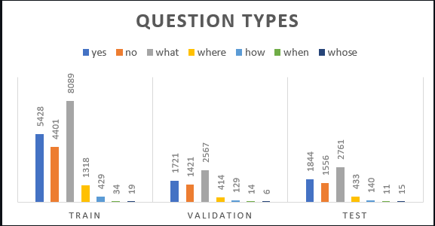
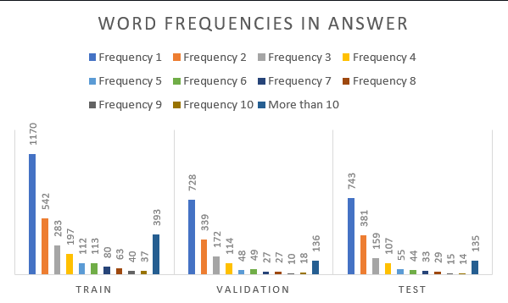
Dataset Statistics
Distribution of type of questions in the dataset.
Plot of frequency of words in answer

Slide 24
Experiment-01
Structured data as convert it into a pandas dataframe and prepare pickle format for later use.
Implement Co-Hierarchical Attention Mechanism in Medical ImageCLEF Dataset 2019.
It attends the image and question simultaneously.
Connect the image and question by calculating the similarity between image and question features at all pairs of image-locations and question-locations.
Gather Preliminary results after training only training images without any data augmentation and regularizer methods.
Pre-trained Resnet model provides better generalization for extracting the image features.

Slide 25
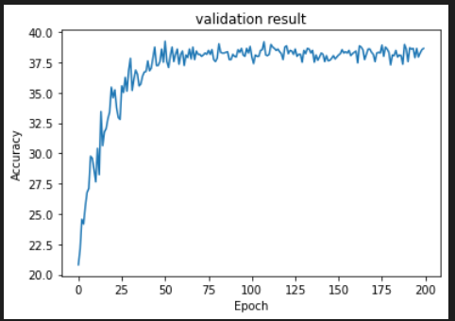
Training Hyperparameters
Learning Rate = 1e-4
Maximum Epochs = 200
Adam Optimizer
Loss Criterion = Cross Entropy

Slide 26
Preliminary Results
The model is trained for 200 epochs and validates on validation data.
The validation accuracy is close to 40%.
Due to smaller size of dataset and no data augmentation will shows the validation accuracy 40% which means there is a scope of improvement by considering the data augmentation techniques.
It seems that attention applied to word level,phrase level and sentence level of questions is not helping much, as the model is getting complex as compared to available data.
Need to simplify the attention mechanism at question level.

Slide 27
Next Steps
Simplify Attention Mechanism at Question level
Implement Pre-trained Bert Model for question level Embeddings.
Add Mixup data augmentation technique or random image pairing for further improvement in accuracy.
Validate result with test data for better accuracy and lower error rate.

Slide 28
TimeLine
Phase 1
MidTerm
Literature Review & Formulation of the Problem
Phase 2
End Term
Implementation of various VQA models on medical Image Dataset
Phase 3
MidTerm
Improve Model and add Mixup technique or Image pairing to Implemented VQA models & Conducting Experiments
Phase 4
End Term
Report Writing & Presentation

Slide 29
THANK YOU

Slide 30
Datasets (ImageCLEF)
2018
Train:
Unique images= 2278
Unique questions=4728
Unique answers =4471
Test :
Unique Images =324
Unique Questions= 331
Unique Answers =389
Validation:
Unique Image =264
Unique Questions= 388
Unique Answers =456
2019
Train:
Unique images =3200
Unique questions= 247
Unique answers =1552
Validation :
Unique Images= 500
Unique Questions= 186
Unique Answers =470
Test:
Unique Image =500
Unique Questions= 138
Unique Answers =470
2020
Train:
Unique images =4000
Unique questions= 38
Unique answers =332
Validation :
Unique Images= 500
Unique Questions= 26
Unique Answers = 232
Test:
Unique Image =343
Unique Questions= 138
Unique Answers =470

Slide 31
CS799: Master’s Thesis Project
Deep Learning Based Approaches for Medical VQA
Department of Computer Science and Engineering
Indian Institute of Technology, Ropar
Instructor:
Deepti R. Bathula:
Assistant Professor
Department of Computer Science & Engineering
Presented By:
Anurag Jaiswal (2021CSM1002)

Slide 32
Contents
Introduction
Phase-02 Summary
Model Architecture
Experimental Results
Conclusion
Future Work
Timeline

Slide 33
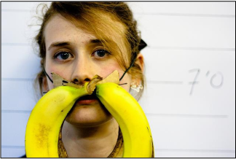
Introduction
AI System
Bananas
What is the mustache made of ?

Slide 34
Introduction
In the medical domain, an image corresponds to a radiology scan of a patient accompanied by a clinically relevant question-answer pair, where the answer might belong to a pre-defined limited set or can be a sequence of words

Slide 35
Phase-02 Summary
Implement Co-Hierarchical Attention Mechanism in Medical ImageCLEF Dataset 2019.
Dataset Analysis and gather Preliminary results after training only training images without any data augmentation and regularizer methods.
Training Hyperparameters such as
Learning rate 1e-4
Adam optimizer
Cross entropy Loss
The validation accuracy is close to 40%.
It seems that attention applied to word level,phrase level and sentence level of questions is not helping much, as the model is getting complex as compared to available data.
Need to simplify the attention mechanism at question level.

Slide 36
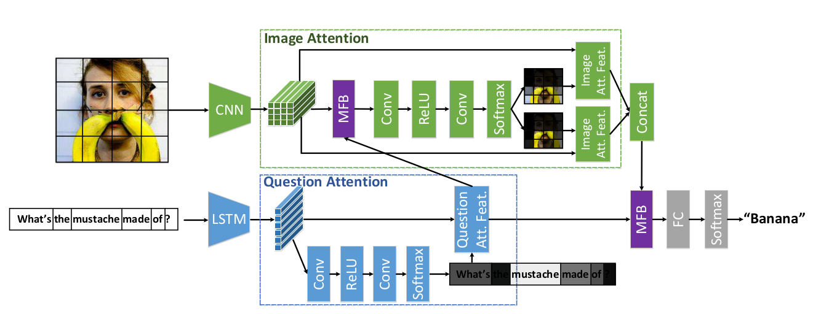
MFB with Co-attention architecture for VQA
Multi-modal Factorized Bilinear Pooling with Co-Attention Learning for Visual Question Answering 2017

Slide 37
MFB with Co-attention architecture for Med-VQA
Experiments with multiple CNNs for model architecture :
VGG19
Resnet-50
VGG19+GAP
Experiments with multiple RNNs for model architecture :
BERT
Bio-Clinical BERT

Slide 38
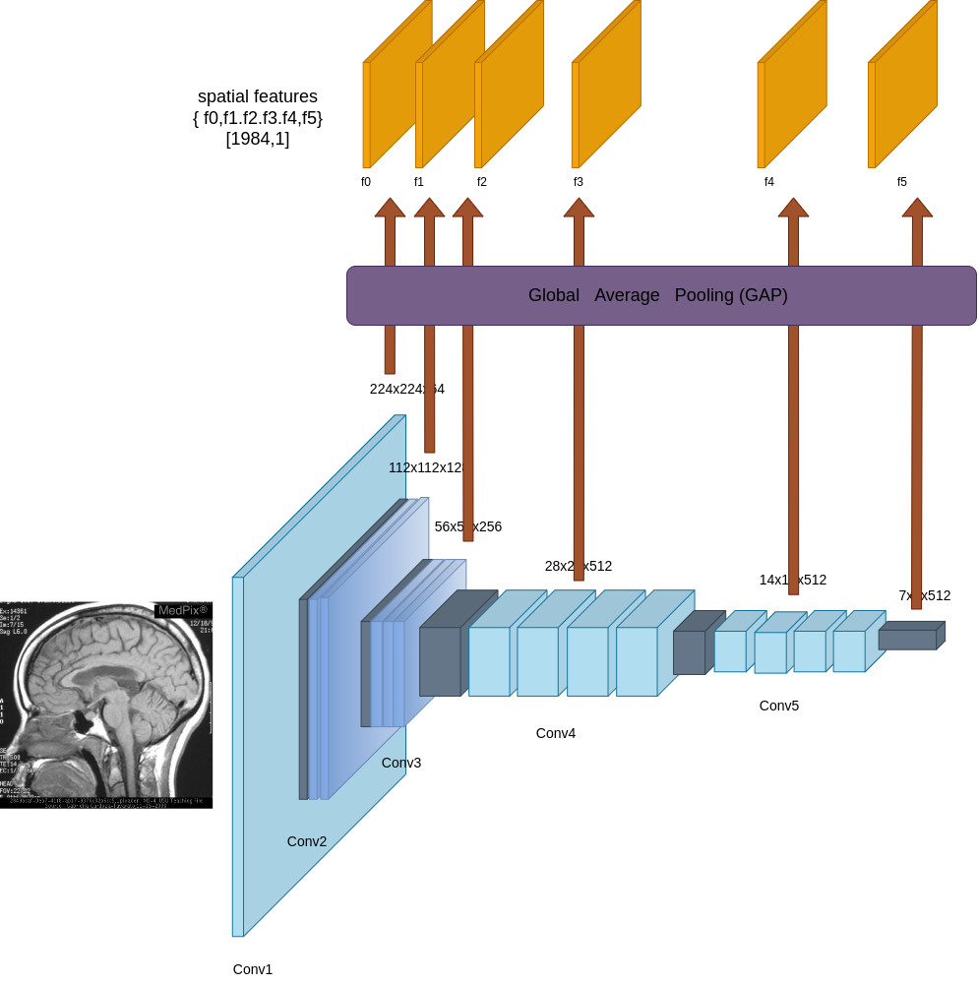
VGG19+GAP ( Global Average Pooling )
Extract feature from pre-trained
VGG19 model from each layer.
Perform global average pooling (GAP) that allows to concat the features which helps in provide more spatial information as compared to VGG19 or Resnet50 only.

Slide 39
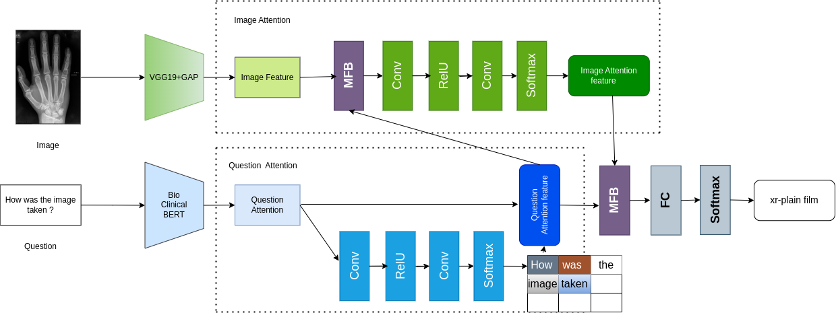
MFB with Co-attention architecture for Med-VQA

Slide 40
VQA MixUp
A data augmentation technique that extends the conventional MixUp to VQA task.
MixUp (MX) : Generate new image V_{mix} with ground truth labels A_{mix} as a weighted combination of original images V_{x} and V_{y} and their corresponding ground truth labels A_{x} and A_{y} using the following equations:
V_{mix}= λV_{x} + (1 − λ)V_{y}
A_{mix}= λA_{x} + (1 − λ)A_{y}
where the value of mixing parameter λ ∈ [0, 1] is chosen randomly from a Beta distribution with α as the hyper-parameter.

Slide 41
Metrics for Vqa-MixUp
VQA model (M) is used to generate predictions P̂x and P̂y for a new image (V̂ ) corresponding to questions Qx and Qy , respectively.
Predictions: P_{x} = M(V_{x},A_{x}) P_{y} = M(V_{y},A_{y})
Mixup Loss: loss_{mix}= λL(P_{x} , A_{x}) + (1 − λ)L(P_{y}, A_{y} )
Top 1 Accuracy: top_acc1_{mix}= λCorrect(P_{x} , A_{x}) + (1 − λ)Correct(P_{y} , A_{y} )
Top 5 Accuracy: top_acc5_{mix}= λCorrect(P_{x} , A_{x}) + (1 − λ)Correct(P_{y} , A_{y} )
Bleu Score: bleu _{mix}= λbleu(P_{x} , A_{x}) + (1 − λ)bleu(P_{y}, A_{y})

Slide 42
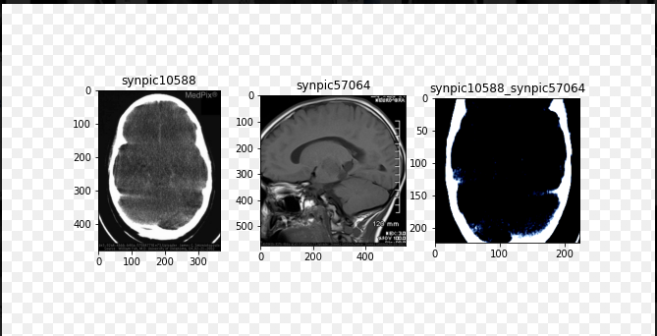
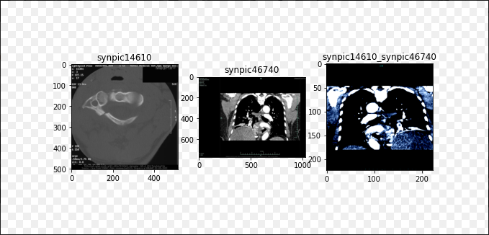
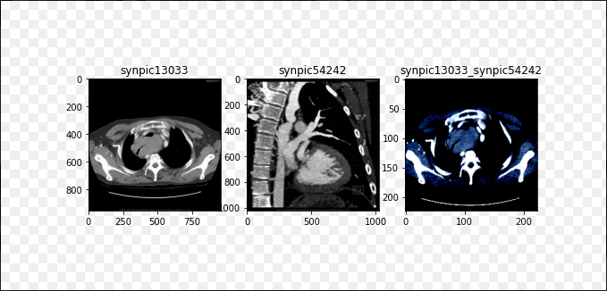
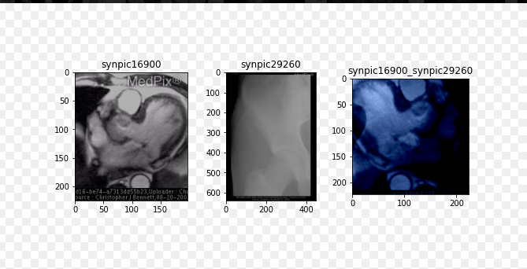
Mixed Images Examples

Slide 43
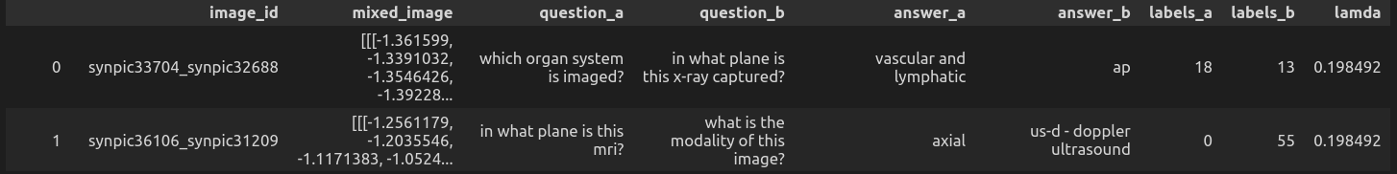
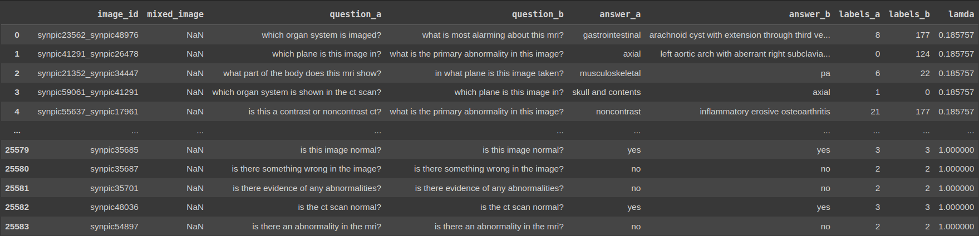
Mixed Images Examples
Mixed Dataset
Original+Mixed Dataset

Slide 44
Experimental Result
Architecture | # classes threshold | Original | Mixed | Original+Mixed | Mixup Coefficient (alpha) | Learning-rate | Training Top 1 Accuracy | Training Top5 Accuracy | Bleu Score (Training) | Best Validation Top1 Accuracy | Best Validation Top5 Accuracy | Bleu Score (Validation) | Testing Accuracy | Modality | Plane | Organ | Abnormality
VGG19+GAP + BERT + MFB + Co-attention | 5 | 1 | 0 | 0 | 0 | 1.00E-04 | 0.8979 | 0.9576 | 0.5101 | 0.7565 | 0.9535 | 0.41 | 0.54 | 0.784 | 0.65 | 0.68 | 0.048
VGG19+GAP + Clinical-BERT + MFB + Co-attention | 5 | 1 | 0 | 0 | 0 | 1.00E-04 | 0.90 | 0.96 | 0.52 | 0.76 | 0.9676 | 0.40 | 0.55 | 0.784 | 0.69 | 0.68 | 0.048
VGG19+GAP + Clinical-BERT + MFB + Co-attention | 5 | 1 | 1 | 1 | 0.1 | 1.00E-04 | 0.81 | 0.89 | 0.46 | 0.73 | 0.9245 | 0.39 | 0.536 | 0.768 | 0.704 | 0.616 | 0.056
VGG19+GAP + BERT + MFB + Co-attention | 5 | 0 | 1 | 0 | 0.2 | 1.00E-04 | 0.8325 | 0.9403 | 0.4655 | 0.668 | 0.9055 | 0.425 | 0.425 | - | - | - | -
VGG19+GAP + BERT + MFB + Co-attention | 5 | 1 | 1 | 1 | 0.2 | 1.00E-04 | 0.80 | 0.87 | 0.4655 | 0.72 | 0.91 | 0.37 | 0.52 | - | - | - | -
VGG19+GAP + BERT + MFB + Co-attention | 5 | 0 | 1 | 0 | 0.4 | 1.00E-04 | 0.6444 | 0.8251 | 0.3548 | 0.6875 | 0.9085 | 0.41 | 0.46 | - | - | - | -

Slide 45
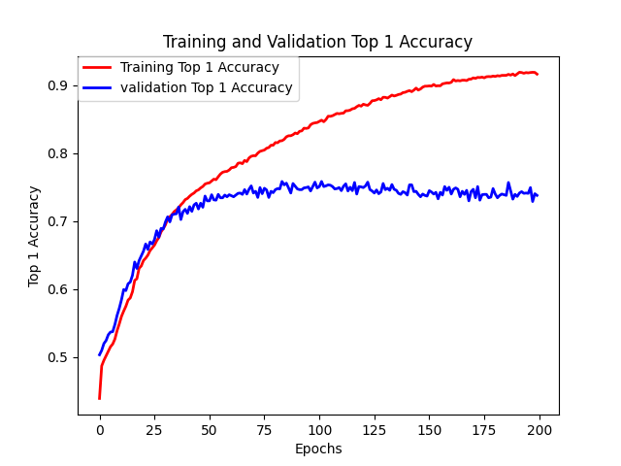
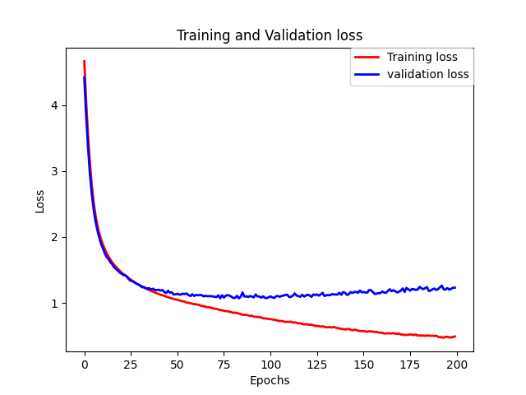
Experimental Result
VGG19+GAP+BERT+MFB
Accuracy
Loss

Slide 46
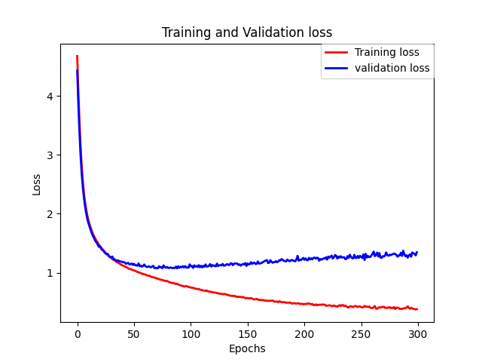
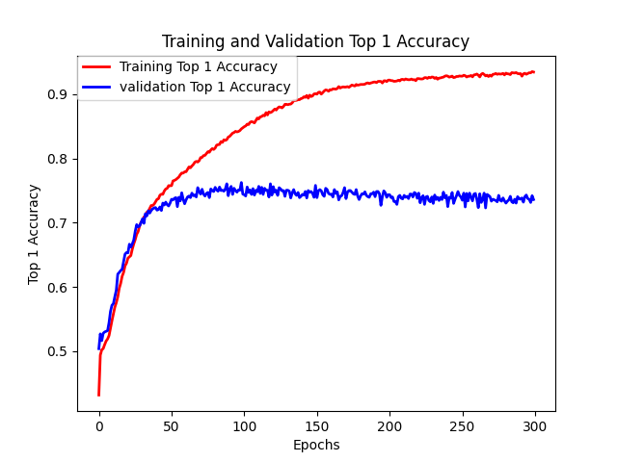
Experimental Result
VGG19+GAP+Clinical BERT+MFB
Loss
Accuracy

Slide 47
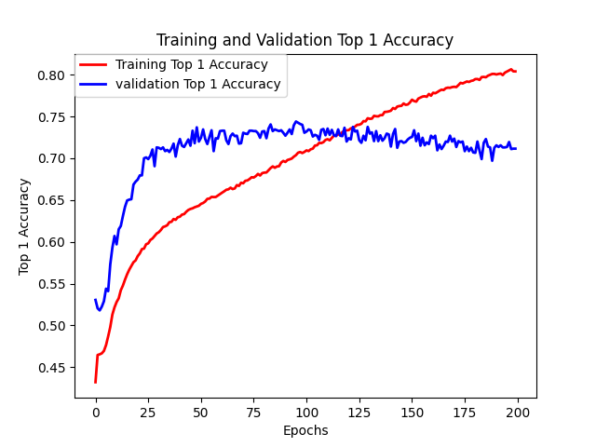
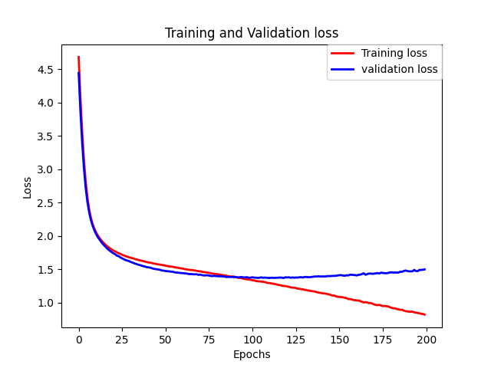
Experimental Result
VGG19+GAP+BERT+original+Mixed
Accuracy
Loss

Slide 48
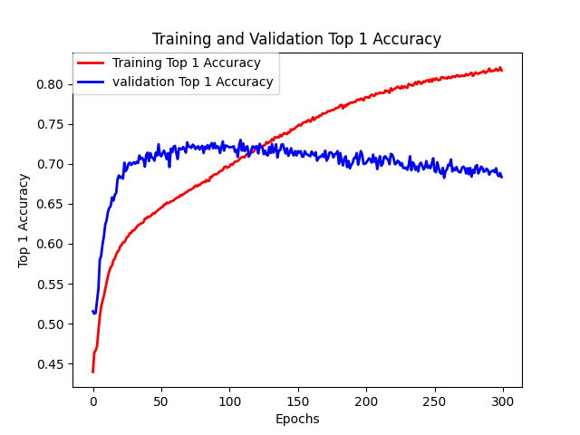
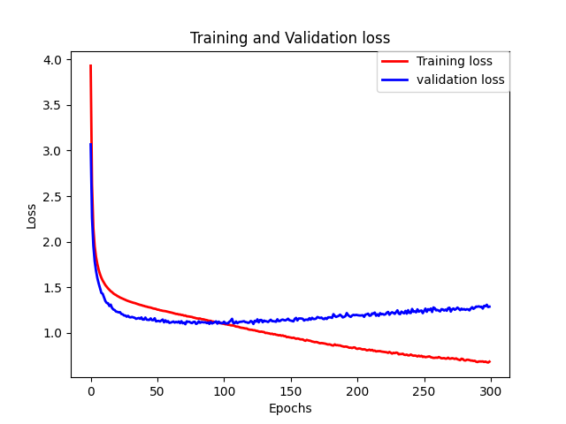
Experimental Result
VGG19+GAP+Clinical-BERT+original+Mixed
Accuracy
Loss

Slide 49
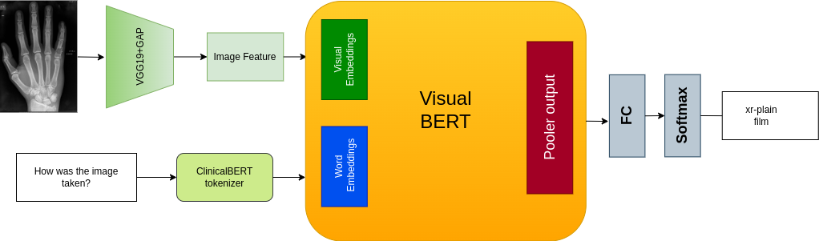
VGG19+GAP+VisualBERT

Slide 50
Cross-Entropy & Contrastive based Combined loss
During a model’s training, the primary goal is to minimize a loss function that measures the difference between the original and predicted output.
When dealing with multi-class classification problems, Cross-Entropy Loss is a well known loss function. However, in certain scenarios such as visual question answering, the model must learn a combined embedding space for both the image and text inputs. In such cases, Contrastive Loss can be used in addition to Cross-Entropy Loss as an additional loss function.
Therefore, we conducted various experiments using combined loss based on contrastive and cross-entropy loss to improve the model’s performance on test dataset.

Slide 51
Experimental Result
Architecture | # classes threshold | Original | Mixed | Original+Mixed | Mixup Coefficient (alpha) | Learning-rate | Training Top 1 Accuracy | Training Top5 Accuracy | Bleu Score (Training) | Best Validation Top1 Accuracy | Best Validation Top5 Accuracy | Bleu Score (Validation) | Loss | Testing Accuracy | Modality | Plane | Organ | Abnormality
VGG19+GAP+VisualBERT | 5 | 1 | 0 | 0 | 0 | 1.00E-04 | 0.65 | 0.89 | 0.35 | 0.66 | 0.91 | 0.35 | Cross-Entropy | 0.46 | 0.56 | 0.624 | 0.52 | 0.048
VGG19+GAP+VisualBERT | 5 | 1 | 1 | 1 | 0.2 | 1.00E-04 | 0.65 | 0.89 | 0.39 | 0.75 | 0.95 | 0.41 | Cross-Entropy | 0.50 | 0.78 | 0.65 | 0.68 | 0.048
VGG19+GAP+VisualBERT | 5 | 1 | 0 | 0 | 0.2 | 1.00E-04 | 0.76 | 0.89 | 0.41 | 0.75 | 0.95 | 0.39 | Cross-Entropy+Contrastive | 0.536 | 0.72 | 0.67 | 0.64 | 0.088
VGG19+GAP+VisualBERT | 5 | 1 | 1 | 1 | 0.2 | 1.00E-04 | 0.75 | 0.89 | 0.51 | 0.68 | 0.94 | 0.41 | Cross-Entropy+Contrastive | 0.55 | 0.78 | 0.65 | 0.68 | 0.088

Slide 52
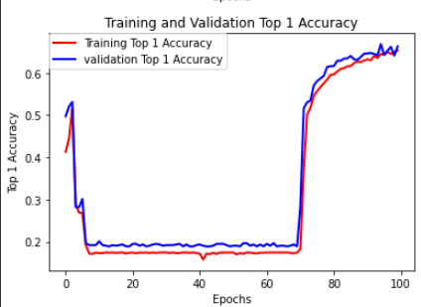
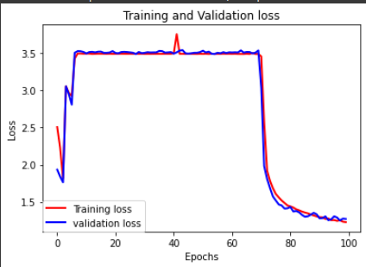
Experimental Result
VGG19+GAP+VisualBERT
Accuracy
Loss

Slide 53
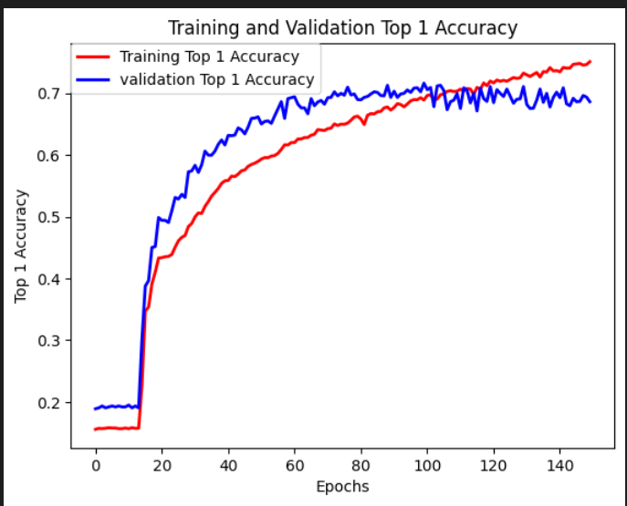
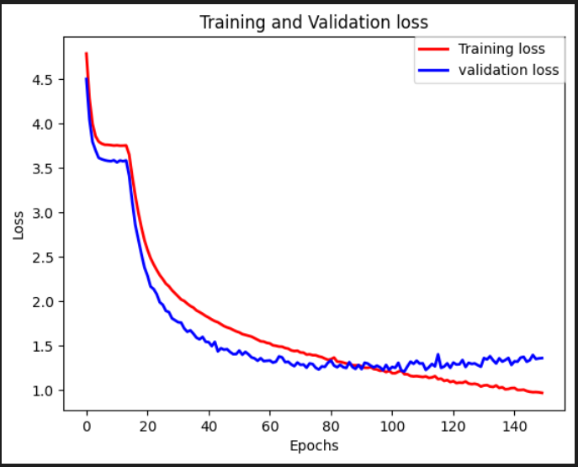
Experimental Result
VGG19+GAP+VisualBERT+combined loss
Accuracy
Loss

Slide 54
Conclusion
VGG19+GAP provides more relevant information features as compared to VGG19 or Resnet-50.
After using original and mixed data combined the model is regularized as training and validation loss and accuracy go down to prevent overfitting but no improvement in test set.
VisualBERT model shows a bit different behaviour in training as model weights starts learning after 70 epoch and then converge.
Addition of Contrastive loss shown significant improvement in accuracy on test dataset.
Both models performs badly for abnormality question category in test set as compared to other categories.
Using Contrastive loss there is slight improvement in abnormality category questions.

Slide 55
Future Work
Several Research papers focuses on domain knowledge training in case of transformers which shows significant improvement in model’s performance.
Implement other mixup techniques such as cut-mix and attentive cut-mix to improve model’s performance.
Improve dataset by annotation and increase its size.
Keep evolving the model by improving mixup techniques.
Try to address the issue of bad performance for abnormality category questions.

Slide 56
TimeLine
Phase 1
MidTerm
Literature Review & Formulation of the Problem
Phase 2
End Term
Implementation of various VQA models on medical Image Dataset
Phase 3
MidTerm
Improve Model and add Mixup technique or Image pairing to Implemented VQA models & Conducting Experiments
Phase 4
End Term
Conduct Experiments & Report Writing & Presentation

Slide 57
THANK YOU

